Slide 1
Working Prototype

Slide 2
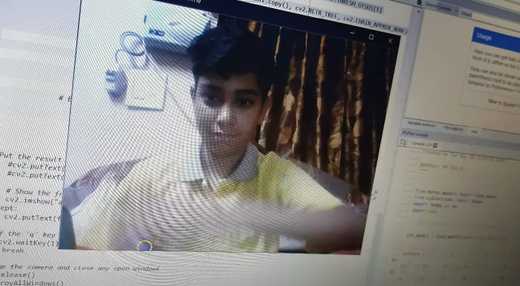
A small demonstration video..

Slide 3
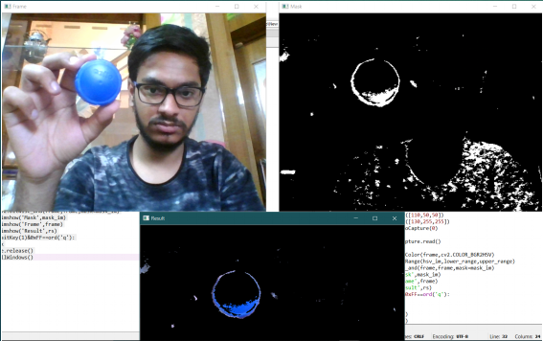
Working principle of Object Tracking: Color Filtering.

Slide 4
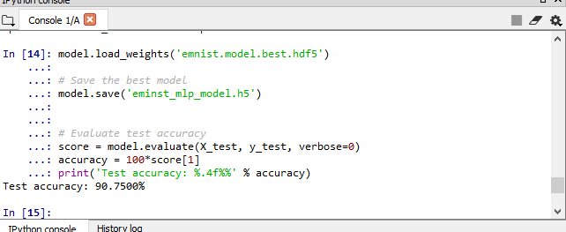
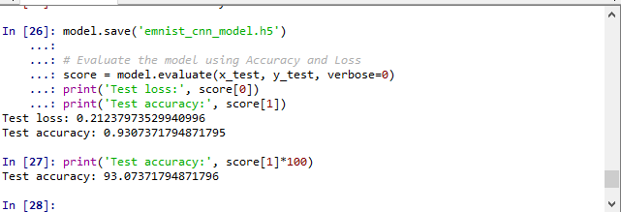
Accuracy Comparison of Trained Deep Learning Model
MLP Model
CNN model

